Slide 1
The Shortest Race

Slide 2
The Shortest Race
You have to race from one tree (A) to another (B) and touch a nearby fence (at point P, say) on the way.
Where should you touch the fence to minimise the distance you have to run?

Slide 3


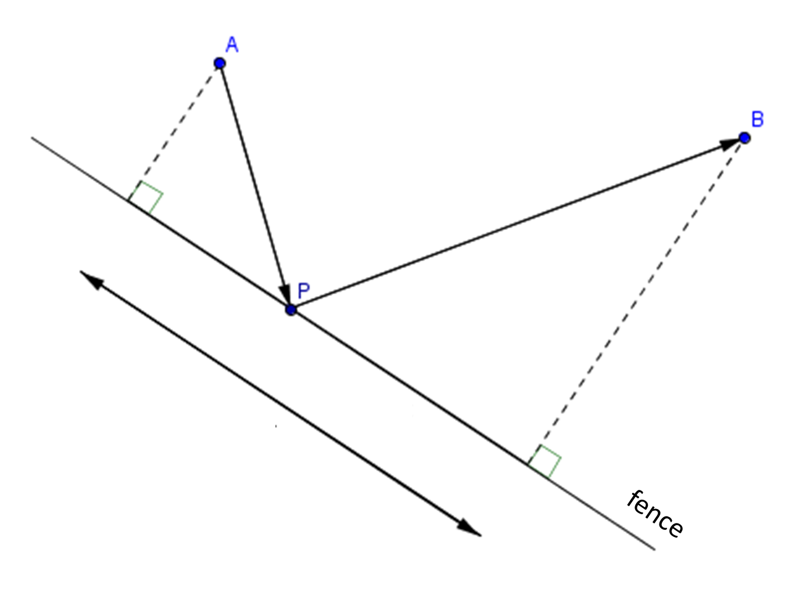
The Shortest Race
33 m
80 m
What’s the shortest distance race?
27 m
SIC_22

Slide 4
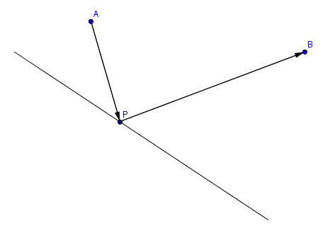
This diagram models the general case.
fence

Slide 5
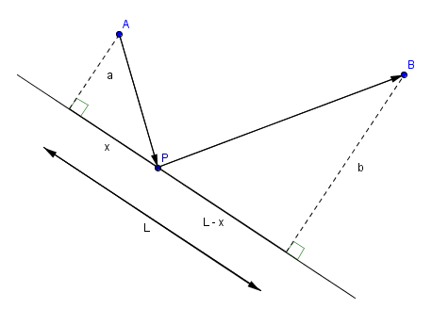
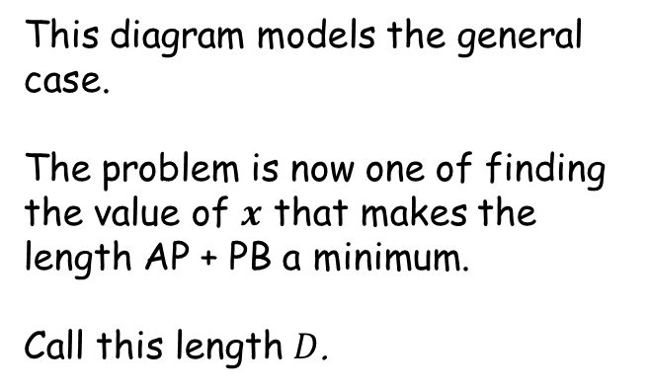
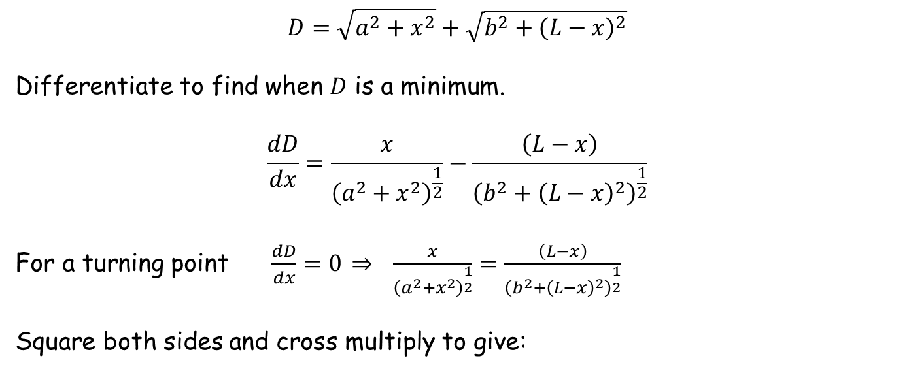
This diagram models the general case.
The problem is now one of finding the value of $x$ that makes the length AP + PB a minimum.
Call this length $D$.
fence
$$D=\sqrt{a^{2}+x^{2}}+\sqrt{b^{2}+{\left(L−x\right)}^{2}}$$
Differentiate to find when $D$ is a minimum.
$$\frac{dD}{dx}=\frac{x}{{\left(a^{2}+x^{2}\right)}^{\frac{1}{2}}}−\frac{\left(L−x\right)}{{\left(b^{2}+{\left(L−x\right)}^{2}\right)}^{\frac{1}{2}}}$$
For a turning point $\frac{dD}{dx}=0 \underset{⇒}{} \frac{x}{{\left(a^{2}+x^{2}\right)}^{\frac{1}{2}}}=\frac{\left(L−x\right)}{{\left(b^{2}+{\left(L−x\right)}^{2}\right)}^{\frac{1}{2}}}$
Square both sides and cross multiply to give:

Slide 6

$x^{2}\left(b^{2}+{\left(L−x\right)}^{2}\right)={\left(L−x\right)}^{2}\left(a^{2}+x^{2}\right)$
$b^{2}x^{2}+x^{2}{\left(L−x\right)}^{2}=a^{2}{\left(L−x\right)}^{2}+x^{2}{\left(L−x\right)}^{2}$
$b^{2}x^{2}=a^{2}\left(L^{2}−2Lx+x^{2}\right)$
$\left(b^{2}−a^{2}\right)x^{2}+2a^{2}Lx−a^{2}L^{2}=0$
$x=\frac{−2a^{2}L±\sqrt{4a^{4}L^{2}+4\left(b^{2}−a^{2}\right)a^{2}L^{2}}}{2\left(b^{2}−a^{2}\right)}$
$x=\frac{−a^{2}L±abL}{\left(b^{2}−a^{2}\right)}$
$x=\frac{\left(−a±b\right)aL}{\left(b^{2}−a^{2}\right)}$
$x=\frac{\left(b−a\right)aL}{\left(b^{2}−a^{2}\right)}$ (ignore negative solution)
$x=\left(\frac{a}{a+b}\right)L$

Slide 7
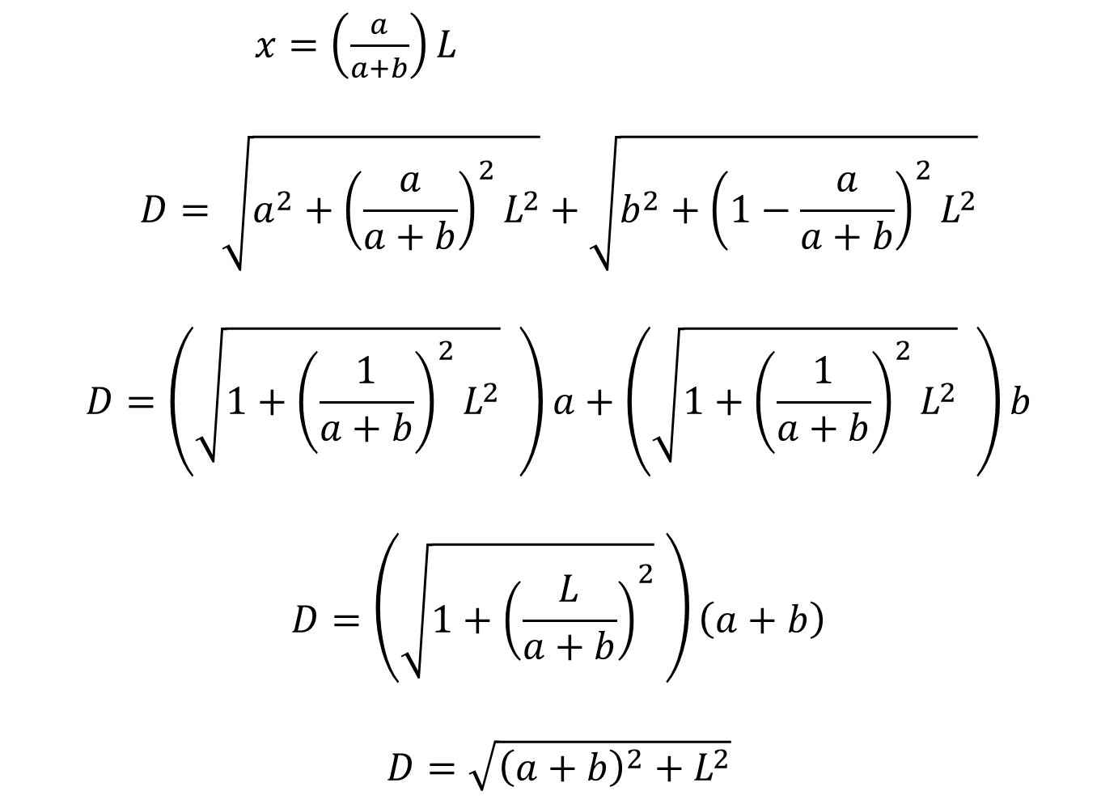
$x=\left(\frac{a}{a+b}\right)L$
$$D=\sqrt{a^{2}+{\left(\frac{a}{a+b}\right)}^{2}L^{2}}+\sqrt{b^{2}+{\left(1−\frac{a}{a+b}\right)}^{2}L^{2}}$$
$$D=\left(\sqrt{1+{\left(\frac{1}{a+b}\right)}^{2}L^{2}} \right)a+\left(\sqrt{1+{\left(\frac{1}{a+b}\right)}^{2}L^{2}} \right)b$$
$$D=\left(\sqrt{1+{\left(\frac{L}{a+b}\right)}^{2}} \right)\left(a+b\right)$$
$$D=\sqrt{{\left(a+b\right)}^{2}+L^{2}}$$

Slide 8
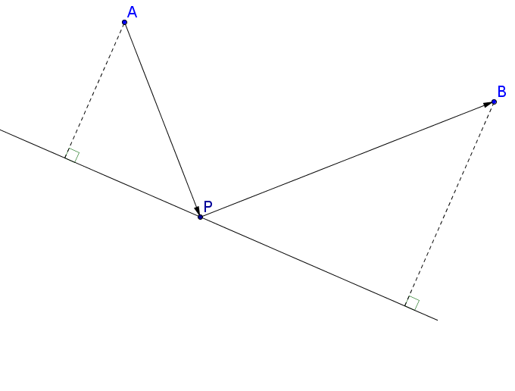







For the minimum distance race (shown below), analysing the angle at P in both triangles shows that they are the same.
$$θ$$
$$a$$
$$θ$$
$$\left(\frac{a}{a+b}\right)L$$
$$θ$$
$$b$$
$$\left(\frac{b}{a+b}\right)L$$

Slide 9





So another way to solve the problem is to simply reflect point A in the fence line to give A’ and join it to point B. Where line A’B crosses the fence line is the solution since length A’P equals length AP.
$$θ$$
$$a$$
$$θ$$
$$\left(\frac{a}{a+b}\right)L$$
$$θ$$
$$b$$
$$\left(\frac{b}{a+b}\right)L$$

Slide 10
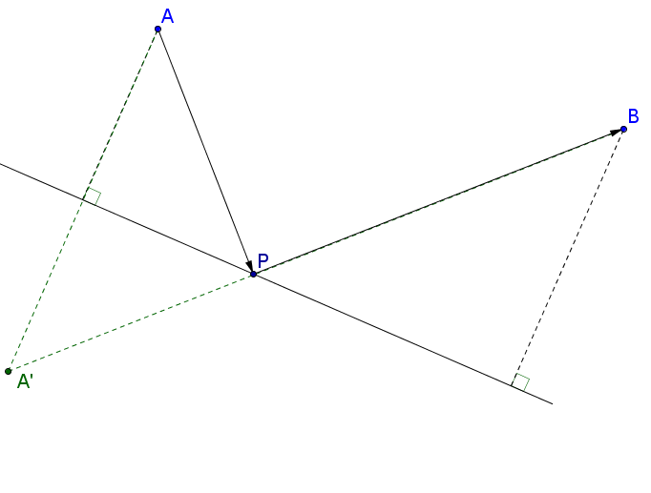



So another way to solve the problem is to simply reflect point A in the fence line to give A’ and join it to point B. Where line A’B crosses the fence line is the solution since length A’P equals length AP.
$$a$$
$$θ$$
$$\left(\frac{a}{a+b}\right)L$$
$$θ$$
$$b$$
$$\left(\frac{b}{a+b}\right)L$$
And a straight line is the shortest distance between two points.

Slide 12
Note to Techer
Each answer is 100 m
You can use the Geogebra file to demonstrate the minimum value

Slide 13
Resources

Slide 14
fence

Slide 15
The Shortest Race
33 m
80 m
What’s the shortest distance race?
27 m
SIC_22

Slide 16
The Shortest Race
36 m
80 m
What’s the shortest distance race?
24 m
SIC_22

Slide 17
The Shortest Race
39 m
80 m
What’s the shortest distance race?
21 m
SIC_22

Slide 18
The Shortest Race
42 m
80 m
What’s the shortest distance race?
18 m
SIC_22

Slide 19
The Shortest Race
51 m
80 m
What’s the shortest distance race?
9 m
SIC_22

Slide 20
The Shortest Race
57 m
80 m
What’s the shortest distance race?
3 m
SIC_22

Slide 21
The Shortest Race
45 m
80 m
What’s the shortest distance race?
15 m
SIC_22

Slide 22
The Shortest Race
50 m
80 m
What’s the shortest distance race?
10 m
SIC_22

Slide 23
The Shortest Race
54 m
80 m
What’s the shortest distance race?
6 m
SIC_22

Slide 24
The Shortest Race
48 m
80 m
What’s the shortest distance race?
12 m
SIC_22

Slide 25
The Shortest Race
43 m
80 m
What’s the shortest distance race?
17 m
SIC_22

Slide 26
The Shortest Race
37 m
80 m
What’s the shortest distance race?
23 m
SIC_22

Slide 27
The Shortest Race
43 m
60 m
What’s the shortest distance race?
37 m
SIC_22

Slide 28
The Shortest Race
46 m
60 m
What’s the shortest distance race?
34 m
SIC_22

Slide 29
The Shortest Race
49 m
60 m
What’s the shortest distance race?
31 m
SIC_22

Slide 30
The Shortest Race
52 m
60 m
What’s the shortest distance race?
28 m
SIC_22

Slide 31
The Shortest Race
61 m
60 m
What’s the shortest distance race?
19 m
SIC_22

Slide 32
The Shortest Race
67 m
60 m
What’s the shortest distance race?
13 m
SIC_22

Slide 33
The Shortest Race
55 m
60 m
What’s the shortest distance race?
25 m
SIC_22

Slide 34
The Shortest Race
60 m
60 m
What’s the shortest distance race?
20 m
SIC_22

Slide 35
The Shortest Race
64 m
60 m
What’s the shortest distance race?
16 m
SIC_22

Slide 36
The Shortest Race
58 m
60 m
What’s the shortest distance race?
22 m
SIC_22

Slide 37
The Shortest Race
53 m
60 m
What’s the shortest distance race?
27 m
SIC_22

Slide 38
The Shortest Race
47 m
60 m
What’s the shortest distance race?
33 m
SIC_22

Slide 39
SIC_22
SIC_22
33 m
36 m
The Shortest Race
The Shortest Race
80 m
80 m
What’s the shortest distance race?
What’s the shortest distance race?
27 m
24 m
Not to scale
Not to scale

Slide 40
SIC_22
SIC_22
39 m
42 m
The Shortest Race
The Shortest Race
80 m
80 m
What’s the shortest distance race?
What’s the shortest distance race?
21 m
18 m
Not to scale
Not to scale

Slide 41
SIC_22
SIC_22
51 m
57 m
The Shortest Race
The Shortest Race
80 m
80 m
What’s the shortest distance race?
What’s the shortest distance race?
9 m
3 m
Not to scale
Not to scale

Slide 42
SIC_22
SIC_22
45 m
50 m
The Shortest Race
The Shortest Race
80 m
80 m
What’s the shortest distance race?
What’s the shortest distance race?
15 m
10 m
Not to scale
Not to scale

Slide 43
SIC_22
SIC_22
54 m
48 m
The Shortest Race
The Shortest Race
80 m
80 m
What’s the shortest distance race?
What’s the shortest distance race?
6 m
12 m
Not to scale
Not to scale

Slide 44
SIC_22
SIC_22
43 m
37 m
The Shortest Race
The Shortest Race
80 m
80 m
What’s the shortest distance race?
What’s the shortest distance race?
17 m
23 m
Not to scale
Not to scale

Slide 45
SIC_22
SIC_22
43 m
46 m
The Shortest Race
The Shortest Race
60 m
60 m
What’s the shortest distance race?
What’s the shortest distance race?
37 m
34 m
Not to scale
Not to scale

Slide 46
SIC_22
SIC_22
49 m
52 m
The Shortest Race
The Shortest Race
60 m
60 m
What’s the shortest distance race?
What’s the shortest distance race?
31 m
28 m
Not to scale
Not to scale

Slide 47
SIC_22
SIC_22
61 m
67 m
The Shortest Race
The Shortest Race
60 m
60 m
What’s the shortest distance race?
What’s the shortest distance race?
19 m
13 m
Not to scale
Not to scale

Slide 48
SIC_22
SIC_22
55 m
60 m
The Shortest Race
The Shortest Race
60 m
60 m
What’s the shortest distance race?
What’s the shortest distance race?
25 m
20 m
Not to scale
Not to scale

Slide 49
SIC_22
SIC_22
64 m
58 m
The Shortest Race
The Shortest Race
60 m
60 m
What’s the shortest distance race?
What’s the shortest distance race?
16 m
22 m
Not to scale
Not to scale

Slide 50
SIC_22
SIC_22
53 m
47 m
The Shortest Race
The Shortest Race
60 m
60 m
What’s the shortest distance race?
What’s the shortest distance race?
27 m
33 m
Not to scale
Not to scale

Slide 51
